Slide 1
Customer Data Analysis
Priyadharshan

Slide 2
Customer Data Analysis
Tools Used
MySQL
Microsoft Excel (Power Query) and Analysis
Power BI

Slide 3
Project Objective & Dataset
Objective
Analyze customer purchasing behavior.
Identify trends based on gender, age, product category, payment method, shopping mall, and time.
Create an interactive dashboard to support business decision-making.
Dataset
Shopping transactions from 10 shopping malls in Istanbul.
Time Period: 2021–2023.

Slide 4
Data Preparation & Analysis
Data Import
Connected to the provided MySQL database using the supplied database credentials.
Imported the customer shopping dataset.
Data Validation
Checked the dataset for NULL values.
Checked for duplicate records to ensure data quality.

Slide 5
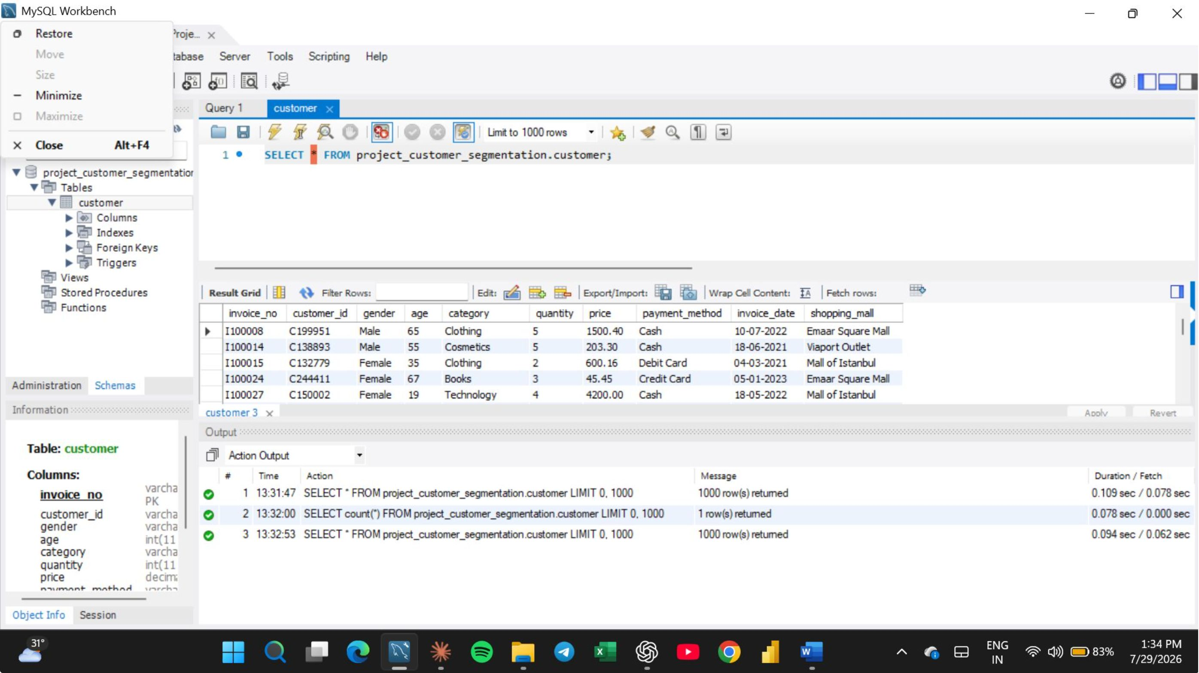
Accessing Customer Data: SQL Databases

Slide 6
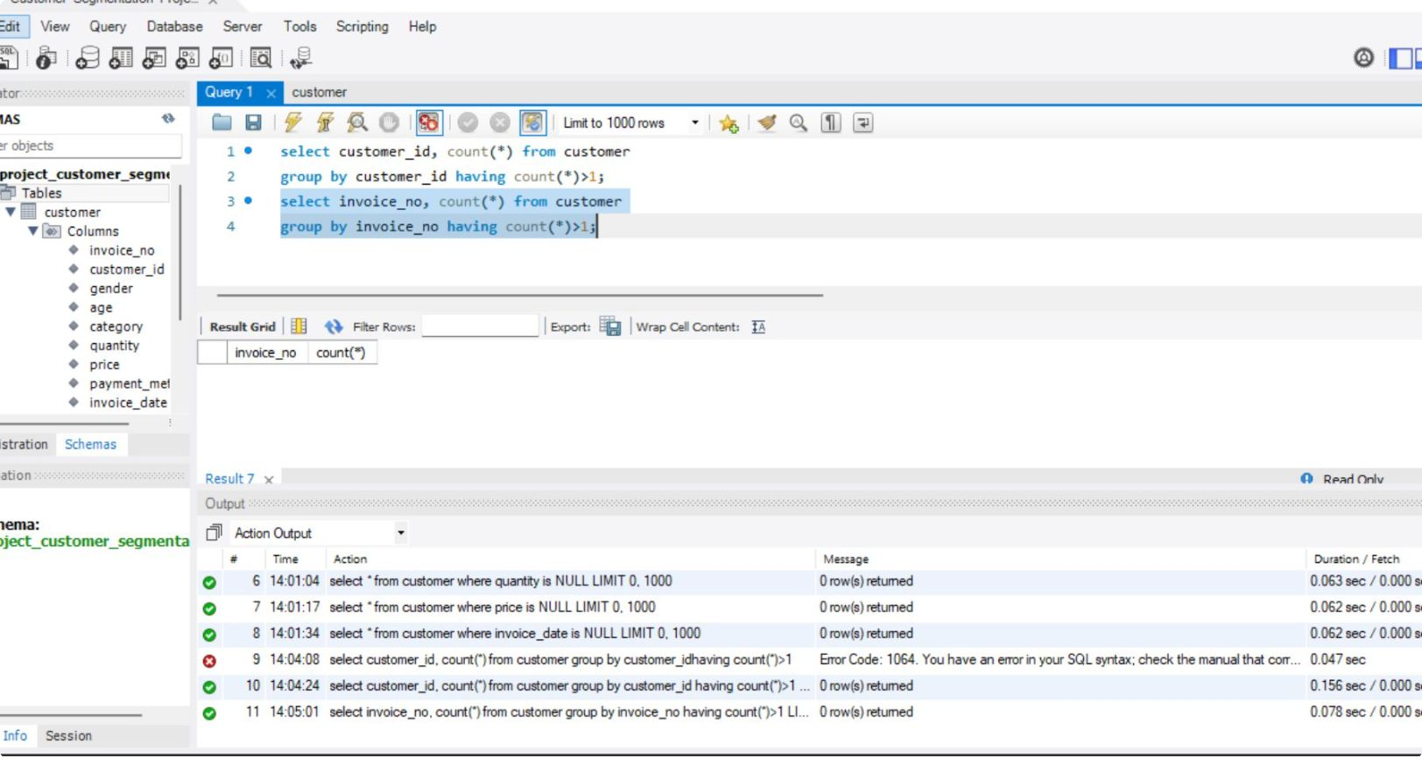
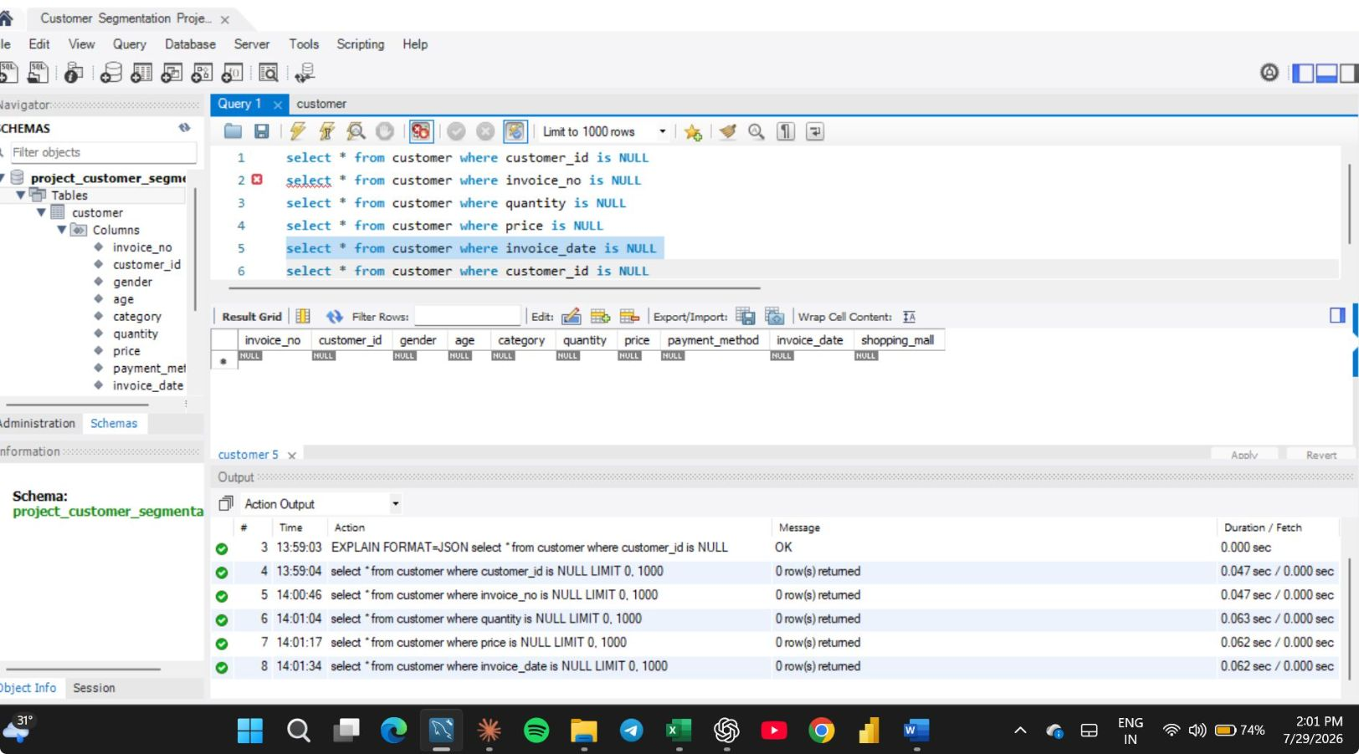
Finding Null values and Duplicates

Slide 7
Data Transformation (Microsoft Excel)
Exported the validated dataset to Microsoft Excel.
Performed data transformation using Power Query.
Created Age Group categories.
Created a Total Amount (Revenue) column.
Prepared the cleaned dataset for visualization.

Slide 8
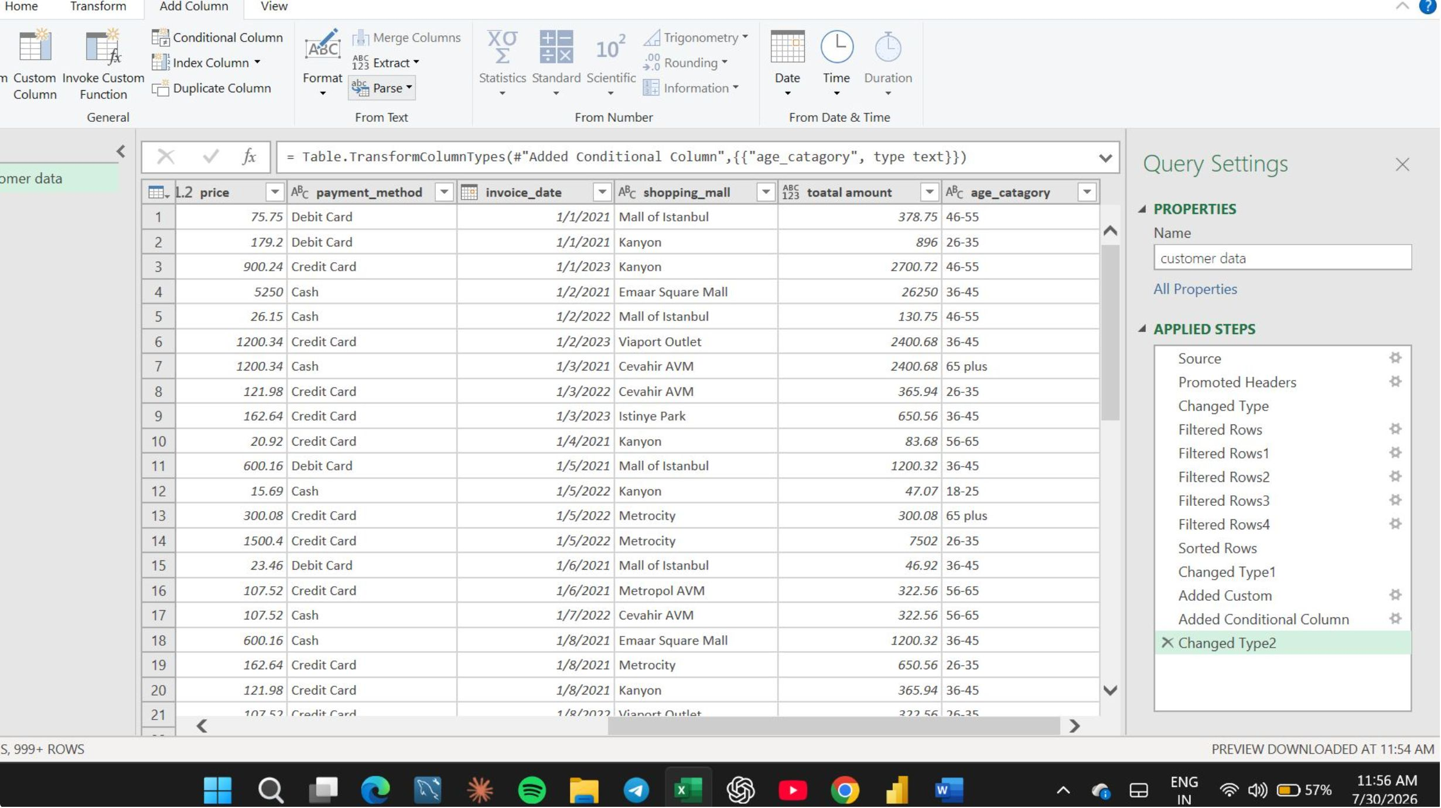
power qwery

Slide 9
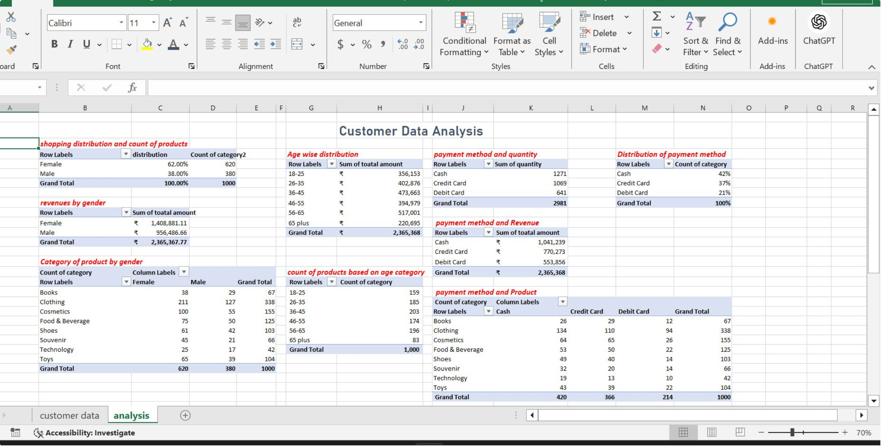
Analysis of Raw data

Slide 10
Power BI Dashboard
Dashboard Features
KPI Cards
Total Revenue
Total Quantity Sold
Total Transactions
Revenue by Gender
Revenue by Age Group
Revenue by Shopping Mall
Payment Method Distribution
Monthly Revenue Trend
Product Category Analysis
Interactive Slicers for Gender, Category, and Shopping Mall

Slide 11
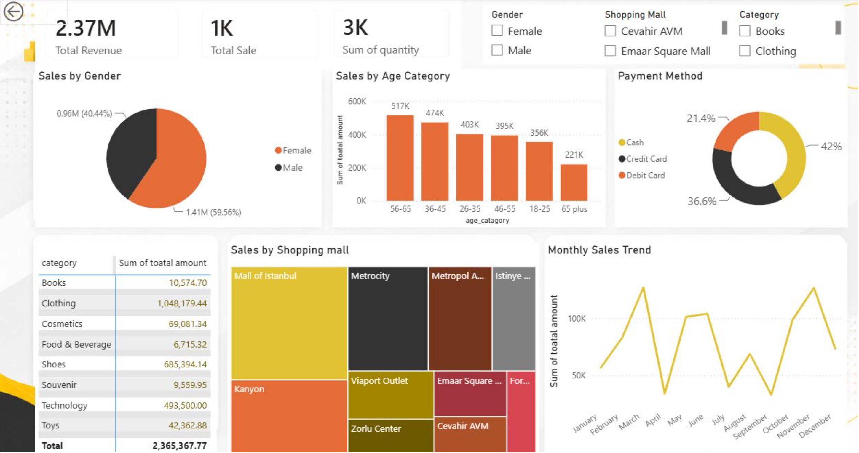
Power Bi visualization

Slide 12
Key Insights
Business Insights
Female customers generated higher revenue than male customers.
The 56–65 age group contributed the highest revenue.
Clothing generated the highest sales revenue.
Cash was the most preferred payment method.
Mall of Istanbul recorded the highest revenue.
Monthly sales showed noticeable fluctuations throughout the year.

Slide 13
Thank You

